Slide 1
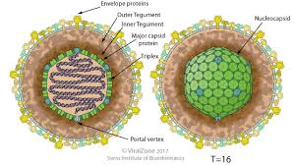

Mini Vidas Automated
Immunoassay System
Valery Taustsiakou

Slide 2
Aims: Diagnosis of viral infection and immunity in paediatrics with serology panels of IgM and IgG
First assays intended for implementation are the CMV, EBV, Measles virus and Varicella Zoster Virus
Rapid testing of measles immunity to protect staff, at-risk infants and faster patient isolation.
System suitable for small volume testing on-site of plasma/ serum of the patient samples.
At present serology testing in TSCUH is carried out at the NVRL.
With the Mini Vidas results will be available within hours rather than days (Reduced Turnaround time).
Verification of measles IgG initially, due to recent outbreaks followed by
CMV , EBV and VZV
Other assays available HIV, Varicella, Rubella, Taxoplasmosis, Hepatitis A/B/C, Procalcitonin.
Notes:
Quickly assess immunity to improve patient flow.
Batching of samples is not required in relation to labelling samples for single assays by serology for IgM antibodies.

Slide 3
Non-culture methods of diagnostics:
Serology is the Ag/Ab reaction in-vitro.
The precence of Abs indicates a recent or previous infection.
An antibody is a chemical structure made up of amino acids, conservative heavy chains and recombinant light chains that vary by B-cell production of different antibodies (Various chemistry of amino acids).
HIV depletes the T-cells needed to present those antigens to the B-lymphocytes that produce the antibodies.
Vidas assay of HIV-1 and HIV-2 Abs, HIV-1 Ag and p24 Ag. Mean period of 3 weeks between contamination and the appearance of the first anti-HIV serum antibodies.
Notes:
Hepatitis also has the core Ag and Abs.

Slide 4
Cytomegalovirus (CMV)- Betaherpesvirinae subfamily, Herpesviridae
CMV is a common virus that rarely causes problems in healthy individuals.
It can cause serious disease in immunocompromised patients .
Women who develop active infection during pregnancy can pass the virus onto baby, with 10-15 % of neonates indicating clinical signs.
Potential hearing, eyesight, motor and overall neural impairment.
Intrauterine growth retardation = premature birth: jaundice.
Neonatal clinical signs:
  -Microcephaly -Lung problems
-hepatosplenomegaly -Seizures
-petechia- purple spots - Mental disability
-jaundice
-Premature birth of unknown aetiology
Can be fatal to patents with AIDS and post-transplant patients.
Notes:
https://www.gov.uk/government/uploads/system/uploads/attachment_data/file/554656/V_28i3.1.pdf
Less than 4 microns/ml at 3 weeks Human cytomegalovirus (HCMV) is a human betaherpesvirus (family Herpesviridae, subfamily Betaherpesvirinae, genus Cytomegalovirus, type species Human herpesvirus 5), which, after primary infection, remains in a latent state for the entire lifetime of the host.[1] HCMV has a ubiquitous distribution, with between 40 and 90% of all adults worldwide carrying the virus.[1,2] In immunocompetent hosts, HCMV usually causes a mild or asymptomatic infection, but it is highly pathogenic in immunosuppressed patients and causes potentially lethal infections, especially in transplant recipients and AIDS patients.[1,3] In addition, HCMV is an important viral cause of fetal infection and may lead to severe clinical complications in the newborn child, such as encephalitis, chorioretinitis, pneumonia, microcephaly and hearing loss, as well as impaired cognitive development.[1,3]

Slide 5
EBV-gammaherpesvirus
CDC: Epstein-Barr virus (EBV), also known as human herpes virus 4, is a member of the herpes virus family. One of the common human viruses. EBV spreads most commonly through bodily fluids, primarily saliva. EBV can cause infectious mononucleosis, also called mono, and other illnesses.
Neonatal/ Infant clinical symptoms:
-fatigue -fever - inflamed throat -swollen lymph nodes in the neck
-enlarged spleen w/ possible rupture -swollen liver -rash
-Ear infections and diarrhoea in children -Guillain-Barre syndrome
Can cause certain cancers, including Burkitt's lymphoma and cancers of the nose and throat
Notes:
https://www.gov.uk/government/uploads/system/uploads/attachment_data/file/443467/V_26i5.pdf
5-10 % of cases are caused by CMV, Toxoplasma gondii, adenovirus, viral hepatitis, HIV, rubella.
Characterised: fever, malaise (difficult to identify illness), sore throat and lymphadenopathy (mononuclear lymphocytosis with atypical lymphocytes)- Increase in CD8 T+ cells.
Lymphadenopathy may be prominent in both the anterior and the posterior triangles of the neck, which distinguishes infectious mononucleosis from bacterial tonsillitis.
Fever, sore throat, swollen lymph nodes in the neck, and sometimes an enlarged spleen which could rupture.
Can cause thrombocytopenia in 25-50 % of cases.
EBV nuclear antigen (EBNA)
Antibody to EBNA, determined by the standard immunofluorescent test, is not seen in the acute phase of EBV infection but slowly appears 2 to 4 months after onset of symptoms and persists for the rest of a person’s life. Other EBNA enzyme immunoassays may report false positive results.
Monospot test not recommended because of the lack of heterophile antibodies in children. Does not fully confirm the presence of EBV but does confirm the typical presence of infectious mononucleosis.
https://www.slideshare.net/mrmodaq/epstein-barr-virus-46848272

Slide 6
EBV types, antibody tests and periods of testing.
Type A EBV worldwide while African type of EBV is type B.
Transmitted through oral secretions, sexual contact, blood transfusions and organ transplants, sharing drinking glasses and toothbrushes.
Viral capsid antigen (VCA): Anti-VCA IgM appears early in EBV infection and usually disappears within 4 to 6 weeks.
Early antigen (EA): Anti-EA IgG appears in the acute phase of illness and generally falls to undetectable levels after 3 to 6 months.
Symptoms of infectious mononucleosis generally resolve within 4 weeks.
Antibody titres of IgM and IgG- if primary or unresolved infection.

Slide 7
EBV antibody test interpretation:
Susceptibility to infection
People are considered susceptible to EBV infection if they do not have antibodies to the VCA. It takes 5-7 days for IgM to develop.
Primary (new or recent) infection
People are considered to have a primary EBV infection if they have anti-VCA IgM but do not have antibody to EBNA. Other results that strongly suggest a primary infection are a high or rising level of anti-VCA IgG and no antibody to EBNA after at least 4 weeks of illness.
Past infection
The presence of antibodies to both VCA and EBNA suggests past infection (from several months to years earlier).

Slide 8
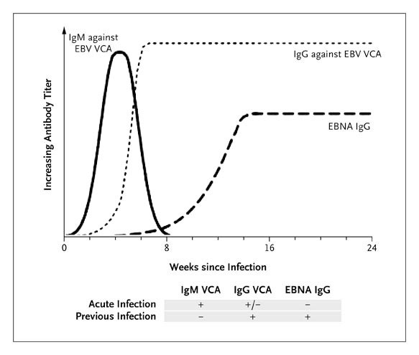
Antibody test interpretation:
Notes:
http://www.nejm.org/doi/full/10.1056/NEJMcp1001116

Slide 9
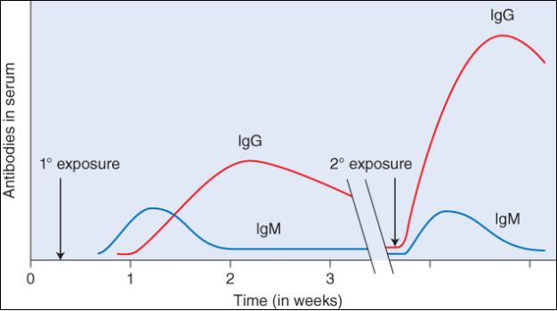
Varicella Zoster Virus- diagnosis and symptoms:
Chickenpox is a very contagious disease caused by the varicella-zoster virus (VZV). It causes a blister-like rash, itching, tiredness, and fever. The rash appears first on the stomach, back and face and can spread over the entire body causing between blisters (duration of illness 5-7 days). Chickenpox can be serious, especially in infants with weakened immune systems.
Main complication is when group A streptococcal infection of skin and tissue.
Symptoms: Fever, fatigue, lack of appetite, headache.

Slide 10
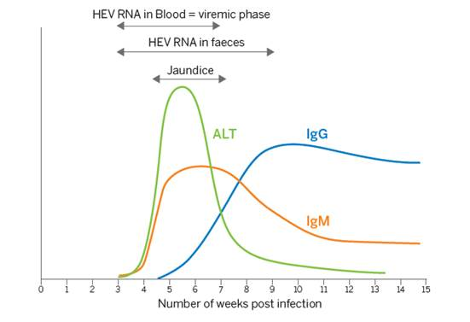
Viral Hepatitis panel:
Screening and aid to diagnosis of recent infection: HAV IgM, HBs Ag Ultra, HBc IgM II, Anti-HCV, Anti-HEV IgM providing a differential diagnosis.
Monitoring of chronic hepatitis: HBs Ag Ultra, HBe/Anti-HBe, Anti-HBs Total II
Determination of hepatitis immune status (pre-post vaccination): Anti-HAV Total, Anti-HBs Total II, Anti-HBc Total II, Anti-HEV IgG
Notes:
http://www.biomerieux-diagnostics.com/vidasr-hepatitis-panel-0

Slide 11
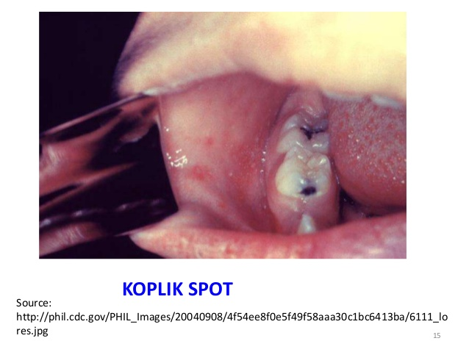
Measles- RNA paromyxovirus
Highly contagious by droplet spread.
Essential lesion of measles is found in the skin, conjunctivae, and the mucous membranes of the nasopharynx , bronchi , and intestinal tract.
Sensitivity of measles IgM limited in first 72 hrs after rash occurs is a possibility. IgM antibodies present when rash appears.
Appears in children of up to 0-9 years of age in developed countries.
generalised erythematous maculopapular rash lasting >3 days and
a temperature >38.0 C and one or more of the following:
cough, coryza (rhinitis), Koplik’s spots or conjunctivitis.
Alternatively, laboratory diagnosis performed with confirmation of positive measles IgM antibodies or isolation of measles virus RNA from respiratory specimens.
For people unable to have their blood drawn, saliva can be collected for salivary measles-specific IgA testing.
Notes:
https://www.slideshare.net/alanisaad/measles-5230049?qid=1b6d38c3-ae42-4965-a086-45df228ecaa8&v=&b=&from_search=1

Slide 12
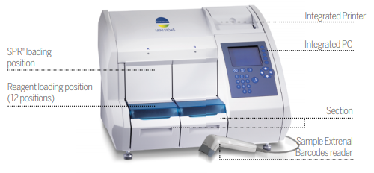
Marketed capabilities and analyser appearance:
Instrument has 12 cartridge compartments.
Specification or promotional page promises different parameters can be set per sample.
Single injection volume set by the instrument after manual assay setup.
Should be the ability to prioritise specimens with STAT testing.
30-36 tests per hour. Indicated 35-60 minutes per test.
Support in obtaining ISO 15189 certification
Compare your internal quality with your peers’ from around the world on the myQC platform.
Westgaurd rules and Levy Jennings charts to measure the Ag/Abs titres.
Instrument applies Windows Xpe software.
https://www.youtube.com/watch?v=mr_2Uf7Y0P8
Notes:
http://data.hnt.no/ftp/eqspublic/pasientforlop/docs/doc_18945/attachments/VIDAS_miniVIDAS_ServiceManual_31-01-2011[1].pdf User setup manual.
Each slot can run 6 tests. So load the strip onto the clips of the well into the surface plasmon resonance compartment.
https://youtu.be/mr_2Uf7Y0P8

Slide 13
Operation of the analyser:
Allow the MINI VIDAS® to warm up for 45 minutes. During initialization, the optical system automatically calibrates against a standard which reacts to temperature. Switch off the MINI VIDAS® . Wait 1 minute and switch on the system again. This operation enables the standard value to be memorized after the temperature has stabilized.
Calibrate every 14-28 days after changing lot number.
Controls run after each new kit and after each calibration to see that the instrument is adjusted to the factory data.
Barcodes scanned with a wand.
If required, leave reagents 30 min at room temperature before use. Check the type of sample and pre-process samples if required.
Dispense the sample volume into the sample well of the strip. After LED light flashes reaction is finished and a printout is printed with the results from the instrument’s side compartment.
Will the assays need to have the patient sample diluted manually, or will there be an option to do this automatically on the instrument?
Notes:
https://www.youtube.com/watch?v=mr_2Uf7Y0P8
Start Section: To start an analysis as soon as SPR® , strips and samples are in position. Status Screen: To know the status of sections A & B and temperature of SPR® and Strip areas. Master Lot Menu: To scan the Master Lot data for any new parameter or new assay lot. Results Menu: Direct access to stored results for validation, print or reprint of assay list. Utility Menu: Con guration of the instrument (e.g.: unit, date & time, user ID, language, printer, barcode wand).

Slide 14
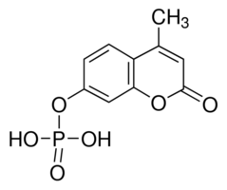
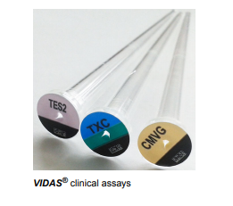
Principle of analyser and antibody capture assay
Solid phase receptacle SPR® is a plastic (polystyrene) device capable of capturing soluble proteins, viruses and bacteria. Within the solid phase base is the capture Ag/Ab to form the sandwich assay and catalyse substrate into fluorescent end product measured at 450 nm.
Reagents are already in the reagent strips.
4-Methyl-umbelliferyl phosphate is the substrate.
Method of calculating fluorescence relative to standard/ reference/ curve fitting depends on the assay used.
Notes:
https://techlib.biomerieux.com/wcm/techlib/techlib/documents/docLink/User_Manual/68246001-68247000/User_Manual_-_161150-849_-_A_-_en_-_mini_VIDAS_-_INDUS_-_US.pdf

Slide 15
Maintenance and laboratory resources
Monthly: Cleaning of the SPR® block Cleaning of the two optical lenses.
Performing VIDAS® QCV test Every 6 Months: Cleaning of the reagent strip area.
Yearly: A preventive maintenance has to be done by a bioMérieux representative.
QCV is quality control Vidas intended to check correct automated pipetting by the system. QCV must be run on all 12 of the used slots of 2 compartments.
20 minutes
checks the optical performance of the fluorescent sensory system.
If slots fluorescence is out of range of the quantifiable fluorescence then run twice more. TV1 fluorescence value must be greater than the kit value near the barcode of the kit.
Notes:
The minividas user manual for the more detailed operation features. Deactivate slot that does not work and phone technical support.
http://www.analysis-laboratorioclinico.com/wp-content/uploads/pdf/mini-vidas-assays-immunoassay-product.pdf

Slide 16
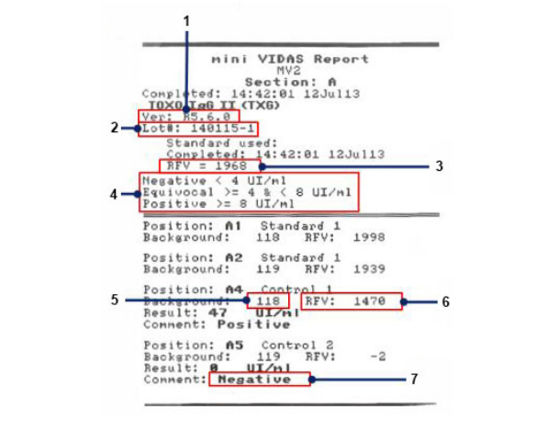
Patient results fluorescence IU/ml titres interpretation
Notes:
https://techlib.biomerieux.com/wcm/techlib/techlib/documents/docLink/User_Manual/68246001-68247000/User_Manual_-_161150-849_-_A_-_en_-_mini_VIDAS_-_INDUS_-_US.pdf

Slide 17
Publication of Mini Vidas assays:
Re-Evaluation of the VIDAS® Cytomegalovirus (CMV) IgG Avidity Assay: Determination of New Cut-Off Values Based on the Study of Kinetics of CMV-IgG Maturation
Vauloup-Fellous C., Berth M., Heskia F., Dugua J.M., Grangeot-Keros L.
Journal of Clinical Virology : the Official Publication of the Pan American Society for Clinical Virology 2013
Dina, J., Creveuil, C., Gouarin, S., Viron, F., Hebert, A., Freymuth, F., Vabret, A. (2016) "Performance Evaluation of the VIDAS® Measles IgG Assay and Its Diagnostic Value for Measuring IgG Antibody Avidity in Measles Virus Infection", Viruses, 8(8), 234.
Huzly, D., Hanselmann, I., Neumann-Haefelin, D., Panning, M. (2016) "Performance of 14 rubella IgG immunoassays on samples with low positive or negative haemagglutination inhibition results", Journal of Clinical Virology, 74, 13-18.
Saville, R., Constantine, N., Cleghorn, F., Jack, N., Bartholomew, C., Edwards, J., Gomez, P., Blattner, W. (2001) "Fourth-Generation Enzyme-Linked Immunosorbent Assay for the Simultaneous Detection of Human Immunodeficiency Virus Antigen and Antibody", Journal of Clinical Microbiology, 39(7), 2518-2524.
Hyun, J., Ko, D., Kang, H., Whang, D., Cha, Y., Kim, H. (2016) "Evaluation of the VIDAS Anti-HCV Assay for Detection of Hepatitis C Virus Infection", Annals of Laboratory Medicine, 36(6), 550.
2009 Jan;44(1):9-14. doi: 10.1016/j.jcv.2008.08.012. Epub 2008 Sep 27. Varicella Zooster Virus.
http://www.biomerieux.com/en/immunoassay-publications
https://patents.google.com/patent/US20170114392A1/en J Clin Virol.
Other immunoassay analysers are Architect, Minilite, Beckman Coulter, Use SciHub for free journal access every time. Aim to check who cited journals in Google scholar for 2018 journal articles.
Notes:
Sensitivity and speciof the assays are detailed and in the respective studies of sensitivity and specificity.

